Slide 1
Amazon Egg Drop Activity
Notes:
Title Slide

Slide 2
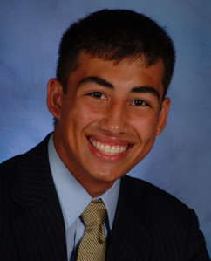
hello!
I am Adam Alvarez Miller
I am a Senior Biomedical Engineering student at the University of Cincinnati, and I would like to showcase my activity in Jillian Richmond’s Physics classroom at Scarlet Oaks.
“RET is funded by the National Science Foundation, grant #EEC -1404766.”
Notes:
Slide 1: Introduce yourself as a senior engineering student and COFSP Recipient, your school and the class of students you are showcasing.
Introduce myself as a COFSP Fellow and the collaboration with RET recipient, Jillan Richmond and my implementation of a physics activity at Scarlet Oaks.
Thank the Choose Ohio First Scholarship Program and National Science Foundation for organizing and funding this opportunity of collaboration between UC and Scarlet Oaks.
“RET is funded by the National Science Foundation, grant #EEC -1404766.”

Slide 3
Physics of Energy
Academic Standards
Energy Conservation
Gravitational Potential Energy
Kinetic Energy
Energy Conversion
Design and Conduct Scientific Investigations
Analyze Models and Explanations
Graph Interpretation
Notes:
Slide 2: Unit Overview: Provide a Topic with the Academic Content Standards identified.
Purpose of my activity? We want to address these Academic Content Standards in ways beyond classroom lecture. Leading an activity provides practicality to modern issues, engages kinesthetic learning, and leads students in good scientific practices such as documentation, testing, data collation, and re-design.
Bullet points address the key concepts utilized and the learning targets for the activity.

Slide 4
Activity Overview and Highlights
Title:
Amazon Egg Drop Activity
Learning Objectives:
Utilize the law of energy conservation and conversion to determine impact velocity.
Describe the forces and energy summation at various points of free-fall.
Learn to design, critique, build, and test various impulse-bearing structures as a team.
Guiding Questions:
What is the potential/kinetic energy of an object when released and just before impact?
When is energy conserved in a system? How is it transformed to reduce impulse force?
What equations are used to describe the energy transformation as an object falls?
Notes:
Slide 3: Activity Highlights: Introduce the Activity by providing the title, learning objectives and Guiding Questions. Include information/pictures about the engineering activities in the Unit.
The learning objectives describe what we want the students to take away at the end of the activity. What have they learned? What are they able to do now? How have they grown to better grasp the concepts?
The guiding questions are meant to probe higher thinking and lead into group discussion. It is also meant to guide a group into researching the answers and discovering new and better concept designs along the way.

Slide 5
Student Test Data
Notes:
Slide 5: Evidence of student learning: Include results of pre and post assessment, displayed graphically if possible. How did students as a whole perform on the pre assessment vs. the post assessment?
We see an increase in correct answers in nearly every question, as well as an overall increase in >1SD from 56% -> 66%. Standard Deviation bars are also smaller on each question in the post-test. This shows a positive increase in overall understanding.
Data does not show p<0.05 however due, in part, to a range of possibilities. Firstly, there were less data points in the post-test than the pre-test (more absentee students). Furthermore, the n-value of both were not very large ~50 for both. Additionally, the variance for both the pre- and post- tests were very large as there is a wide range of disciplines and academic skills among the classes of a vocational school. This large variance has a profound impact on the Chi^2 and subsequent p-value of the data.
Overall, I believe that this was a positive activity and the increase in question and cumulative averages shows me that the students certainly took some positive learning out of the experience. Furthermore, this exercise was meant to have students practice team-building skills and hands-on learning to supplement their classroom knowledge, which I believe it accomplished.

Slide 6
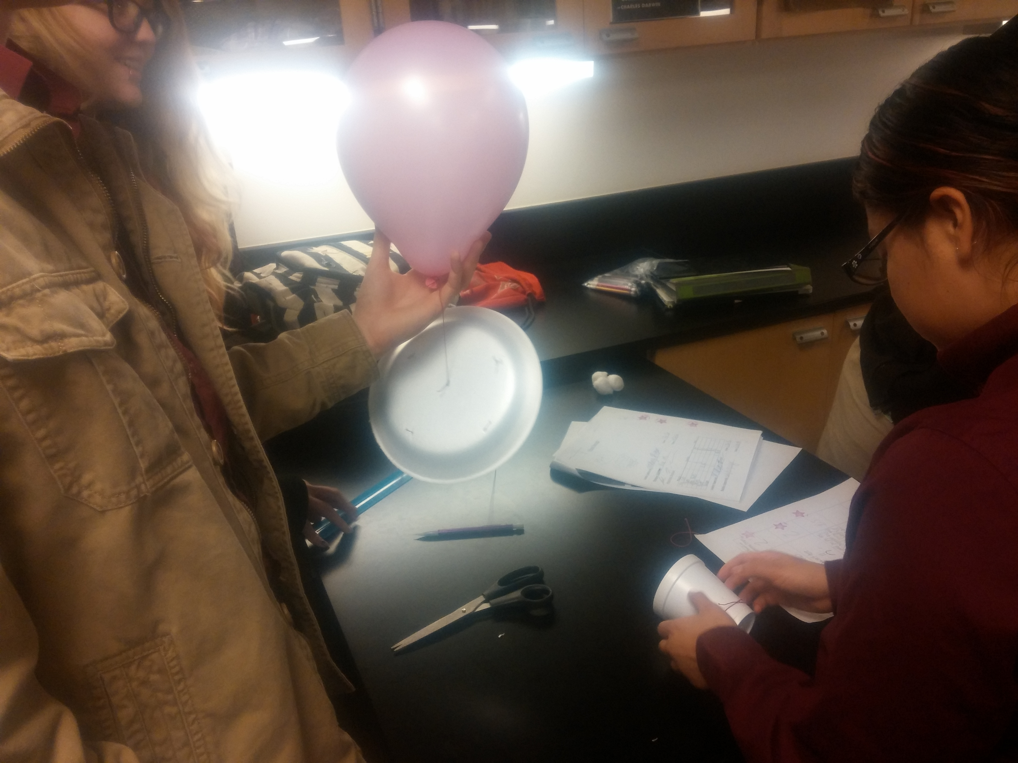
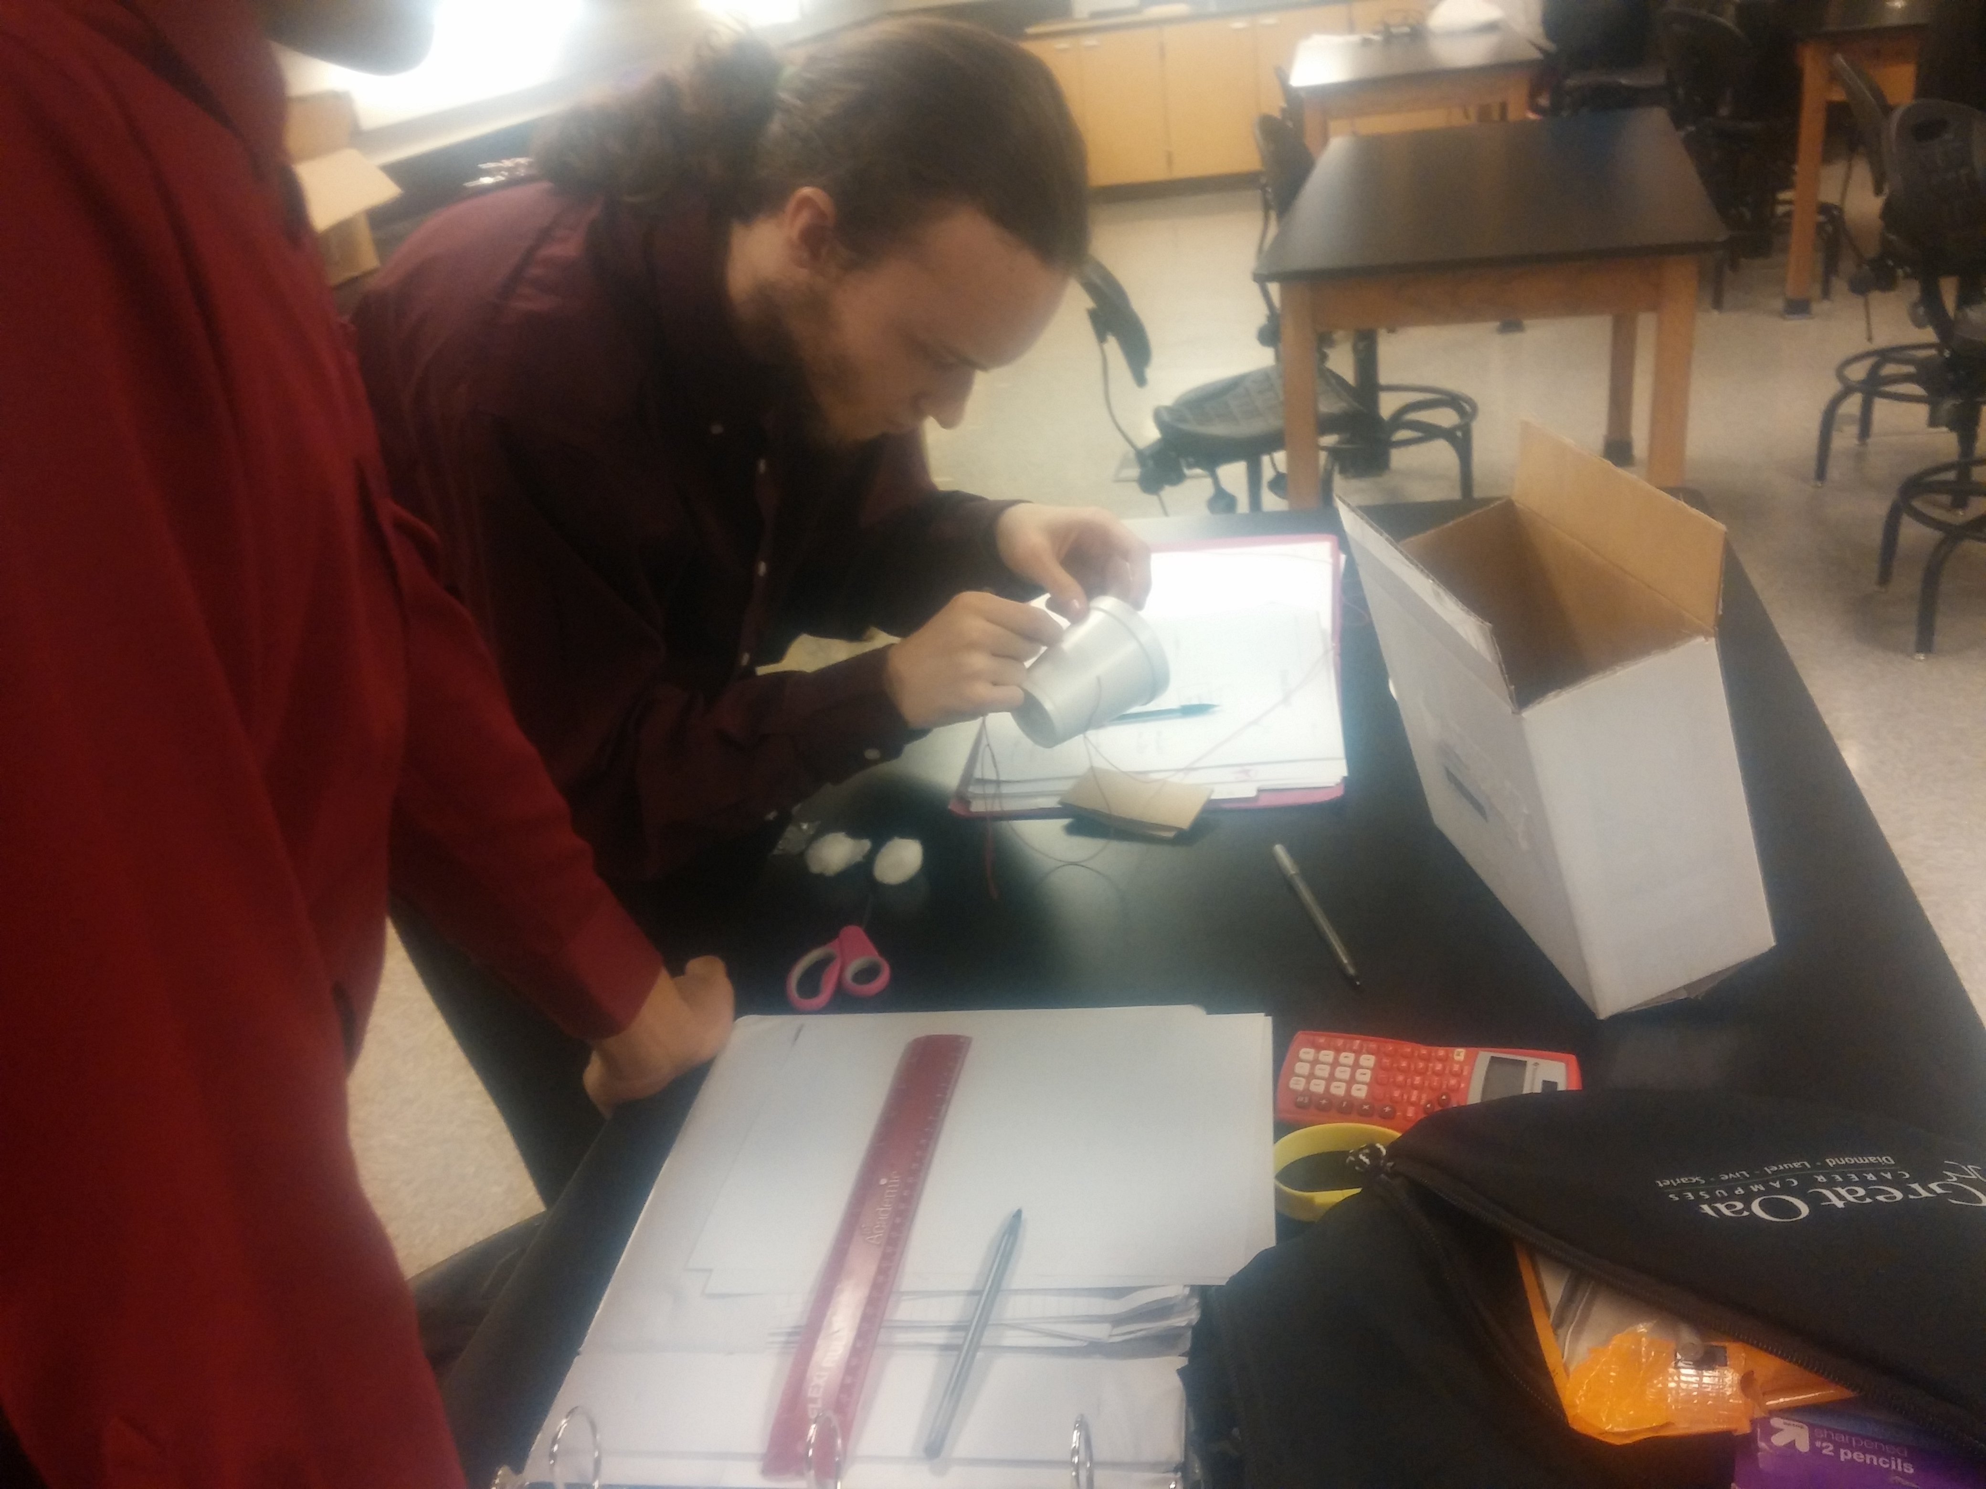
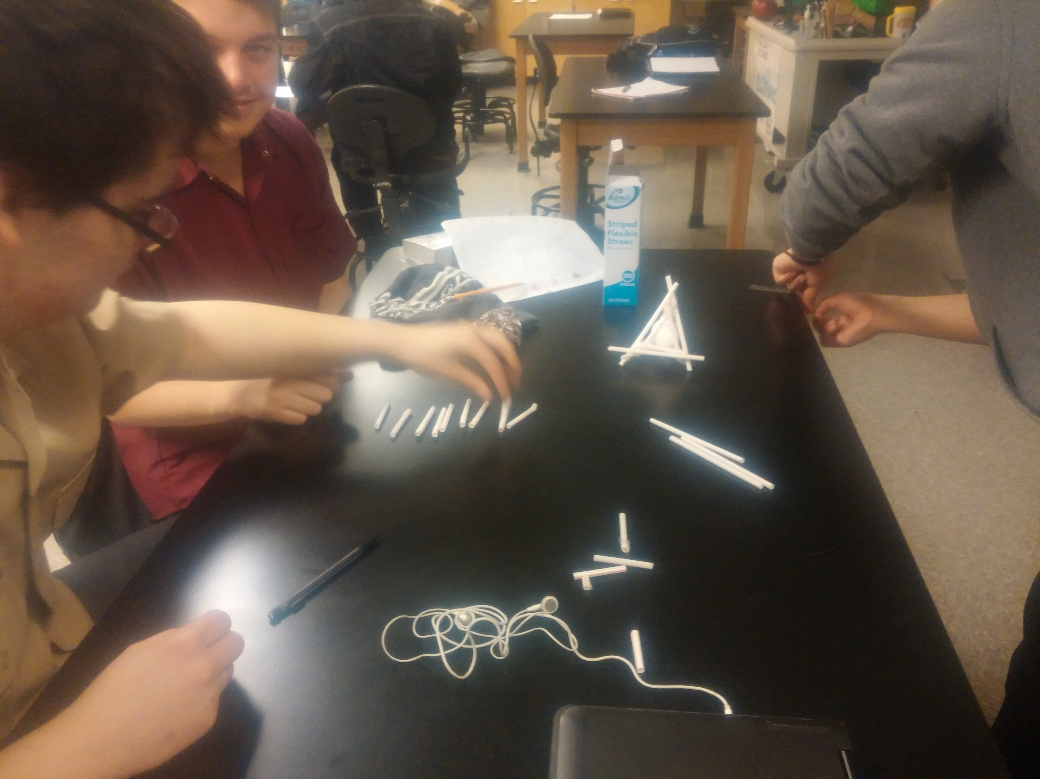
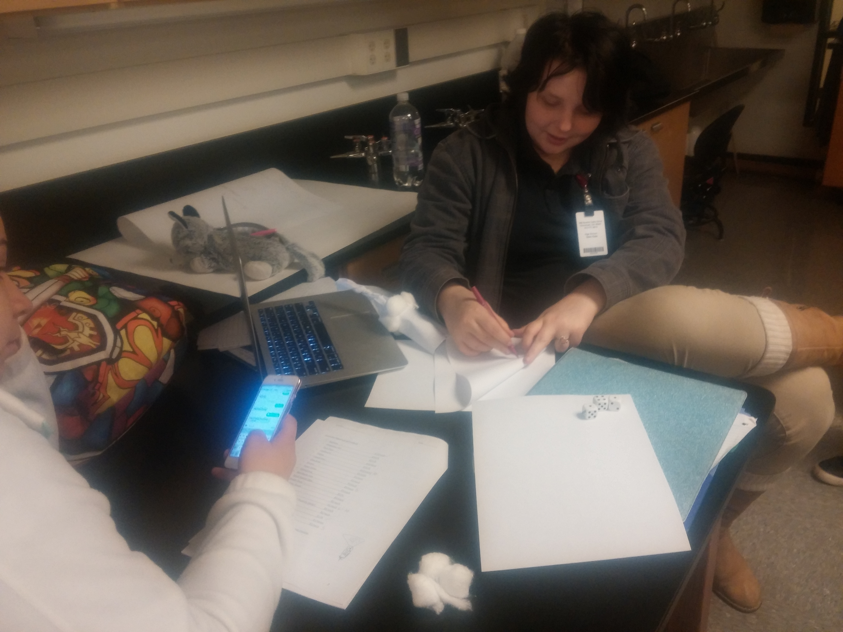
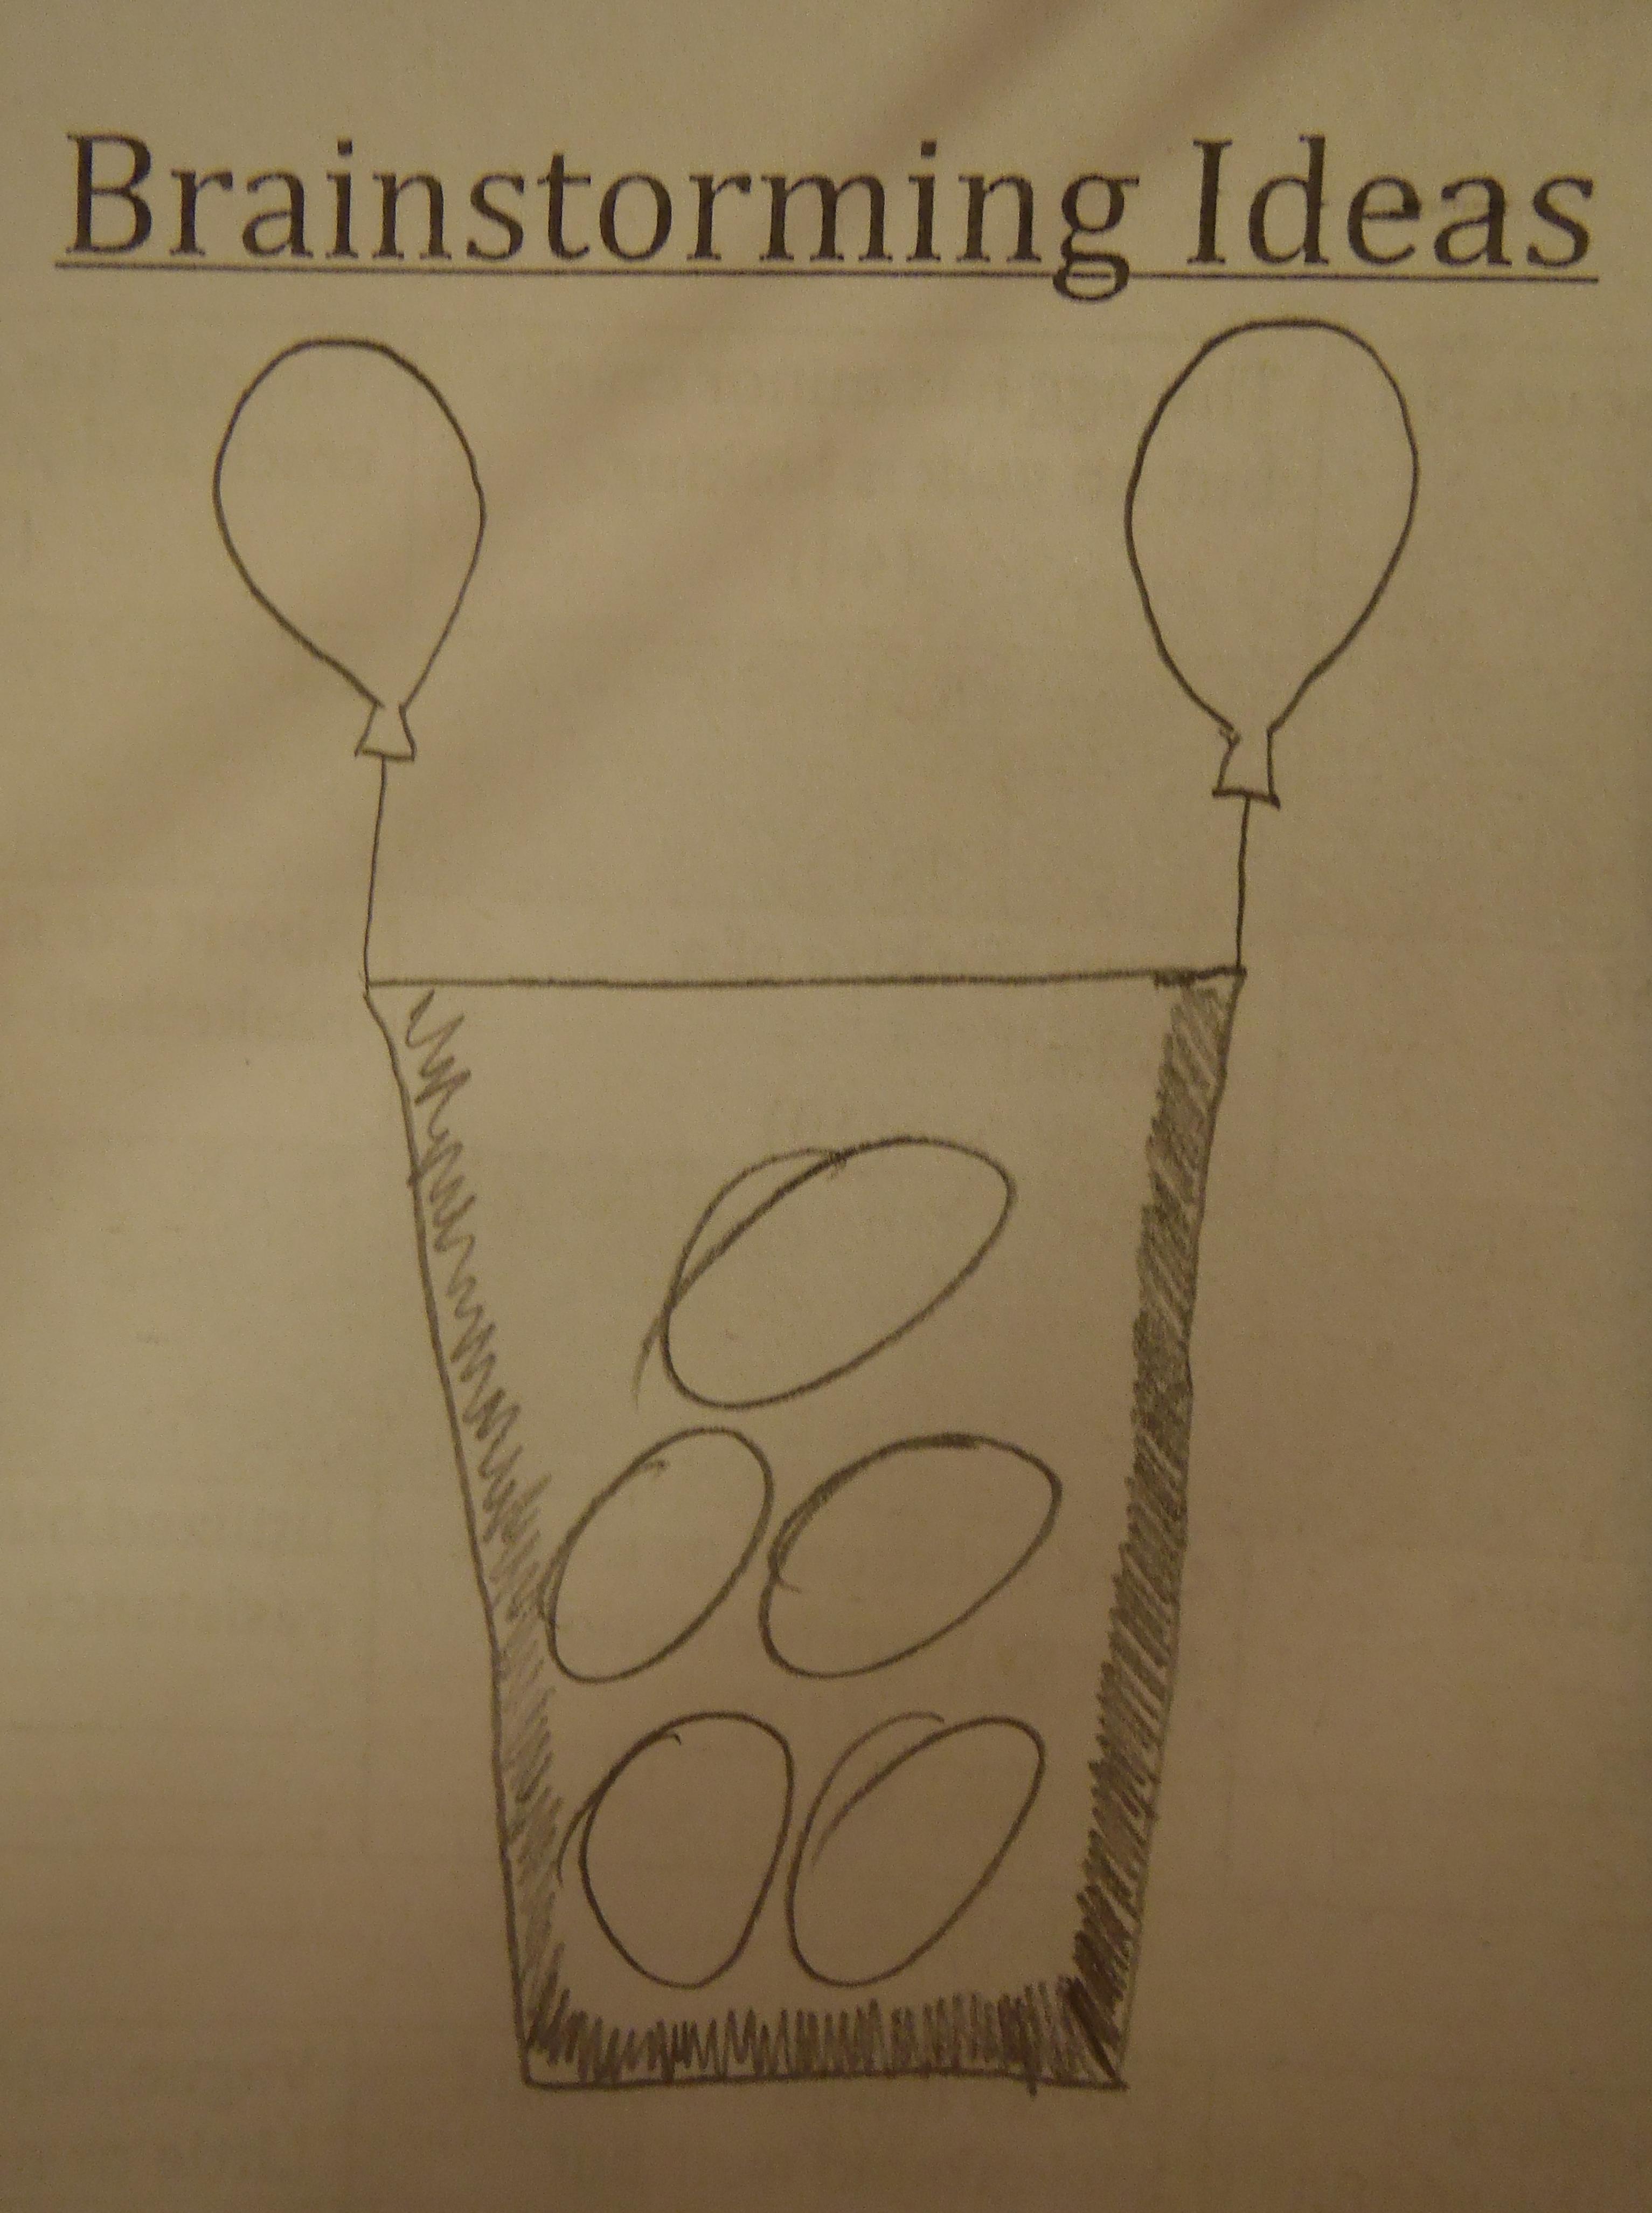
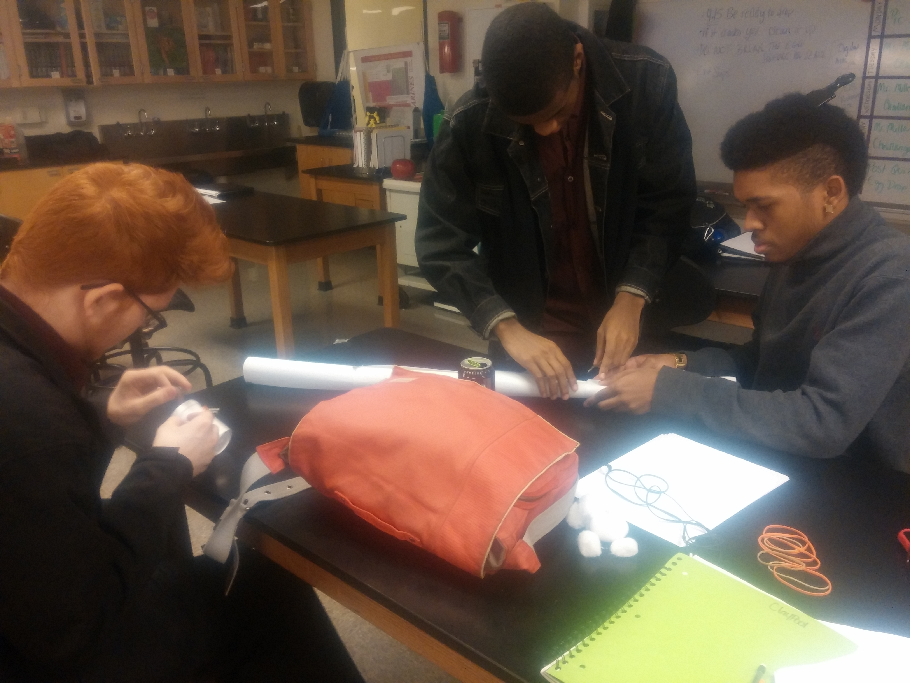
Activity in “Action”
Students brainstorm various designs.
Teams work together to build their prototype.
Teams put their structure to the ultimate drop test
Notes:
Slide 6: Activities: Include information/pictures about the engineering activities in the Unit.
Designs and different student approaches to the same problem – air drag, rotation, elasticity, deformation, friction.
Team dynamics – cooperation, delegation, personality clashes, natural leaders, on-the-fly design changes.
Drop Tests – Some worked beautifully, some needed work, some had too many variables.
FUN!!
Spinner - https://drive.google.com/file/d/0B_bQvHuzpl1kRlN5ZGtuT3JFUU0/view?usp=sharing
Pyramid - https://drive.google.com/file/d/0B_bQvHuzpl1kbERlZHpqaXZsV00/view?usp=sharing
Plate parachute - https://drive.google.com/file/d/0B_bQvHuzpl1kOUpNd3hOdDZCVjA/view?usp=sharing
Giant Parachute - https://drive.google.com/file/d/0B_bQvHuzpl1kbzVkQWRUbXdzZnc/view?usp=sharing
Tube Drop - https://drive.google.com/file/d/0B_bQvHuzpl1kUkY0SzBOTDQ0a1E/view?usp=sharing

Slide 7
Activity Reflections
Successes
Framed in real-world context.
Challenging Pre/Post test
Team structure
Creative problem solving
Kinesthetic learning
Documentation and EDP
FUN!!
What I learned
Competition gets students excited
Learn by doing
Forced cooperation and teamwork
Shortcomings
Broad scope of material
Not enough time
Tougher constraints
More time for discussion
More example problems
Confusing equation manipulation
What I learned
Students learn from one another
Equations can cause confusion
Important to address WHY?
Notes:
Slide 7: Reflections: What are your reflections on the Unit implementation?
What worked? Why? What did I learn?
What failed/was difficult? How can I do better next time? What did I learn?
“RET is funded by the National Science Foundation, grant #EEC -1404766.”

Slide 8
Thank You!

